Slide 1
Cosine Transformations : Amplitude and Period
By: Shannen Skinner

Slide 2
The problem we are going to solve is:
y=3cos3x
Where to start?
Find the amplitude.
Find the period.
Set up graph.
Graph equation.

Slide 3
Step 1) Find the amplitude.
y=3cos3x
The amplitude is the highest and lowest point of the wave/circle. It is found in front of the function.
Start/End
3
-3

Slide 4
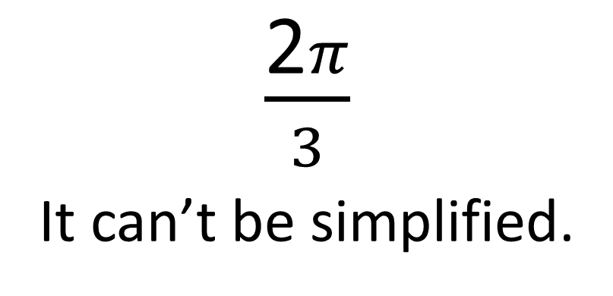
Step 2) Find the period.
$\frac{\text{2}π}{3}$
It can’t be simplified.
y=3cos3x
The period is how you determine how stretched the wave will be. You find it by taking the number with the variable and dividing 2$π$ by it.
$$\frac{\text{2}π}{3}$$

Slide 5
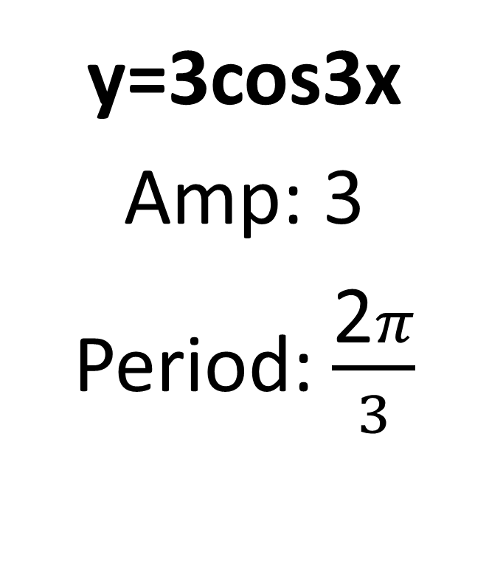
Step 3) Set up graph.
To find the numbers between 0 and 2$π/3,$ multiply 2$π/3$ by what you’re finding.
$Ex: \frac{2π}{3}$ *$\frac{1}{2}$ = $\frac{2π}{6}$ = $\frac{π}{3}$
$\frac{2π}{3}$ *$\frac{3}{4}$ = $\frac{6π}{12}$ = $\frac{π}{2}$
$\frac{2π}{3}$ *$\frac{1}{4}$ = $\frac{2π}{12}$ = $\frac{π}{6}$
y=3cos3x
Amp: 3
Period: $\frac{\text{2}π}{3}$
3
$$\frac{π}{6}$$
$$\frac{π}{3}$$
$$\frac{π}{2}$$
$$\frac{\text{2}π}{3}$$
-3

Slide 6
Step 4) Graph equation.
$$\frac{π}{6}$$
y=3cos3x
0
$$\frac{π}{3}$$
Start / End
$$\frac{\text{2}π}{3}$$
$$\frac{π}{2}$$
$$\frac{π}{6}$$
$$\frac{π}{3}$$
$$\frac{π}{2}$$
$$\frac{\text{2}π}{3}$$
*The relation between the circle and the graph is they are the same just in different forms. The graph is just the circumference of the circle laid out on a graph.*
-3
*Note: The wave starts at 0 on the x-axis and 3 on the y-axis. When you see cos in the equation your wave will always start at (0,amp.)*

Slide 7
This is were I wave goodbye…so
Goodbye.
SEE YOU LATER!! BROFIST!

